Slide 1

PROJECT PRESENTATION
ON
A
ONLINE HOSPITAL MANAGEMENT SYSTEM
Developed By :
Dixit Vora : 22032211266
Jignesh Shah : 22032211228
Guided By :
Prof. Hiral B. Patel
:: Group No :- 103 ::
:: Submitted To ::
Acharya MotiBhai Patel Institute of Computer Studies, Ganpat University, Ganpat Vidyanagar - 384012

Slide 2
Project Profile
Project Title | Online Hospital Management System
Objective | The user can digitally take the appointment
Front End Tool | HTML, CSS, JavaScript
Back End Tool | MY SQL(8.0.30), Python(3.12.1)
Framework | Django(5.1.5)
Group No. | 103
Team Member | Dixit Vora [22032211266] Jignesh Shah [22032211228]
Project Guide | Prof. Hiral B. Patel
Operating System | Windows 11
Developed At | Acharya Moti Bhai Patel Institute of Computer Studies
Developed For | Acharya Moti Bhai Patel Institute of Computer Studies

Slide 3
Existing System
Limited online booking or cancellation functionality.
Manual or semi-automated entry of medical history.
Appointment book in not verify for patients.
Time consuming.
Not available 24/7.

Slide 4

No need to visit hospitals for booking appointments.Easy access to doctor schedules and appointment history..
Very fast online appointment booking.
Instant notifications for Booked Appointments.
More security for using verify code in register system.
Available 24/7.

Slide 5
(a) Client Side:-
System Requirement
Hardware Requirement (Recommended)
Hardware | Minimum Requirement
Processor | Intel(R) Core(TM) i5-1035G1
RAM | 2GB or above
Hard-disk Space | 50GB or above.
Hardware | Minimum Requirement
Processor | Intel(R) Core(TM) i5-1035G1
RAM | 4GB or above
Hard-disk Space | 50GB or above.
(b) Server Side:-

Slide 6
System Requirement
Software Requirement (Recommended)
(a) Client Side:-
Software | Minimum Requirement
Web Browser | Chrome or Edge
Operating System | Windows 11
Software | Minimum Requirement
Operating System | Windows 11
Front End | CSS, HTML,JAVASCRIPT
Server | Xampp
(b) Server Side:-

Slide 7
System Flow Chart - Admin
Start
Username/Password
Login
NO
YES
View Website
View all appointments
A

Slide 8
A
Add & View Doctors
View Patients
Add & View Staff
Logout
STOP

Slide 9
START
System Flow Chart - User
View Homepage
View Doctor Profile
You want to Book Appointments
?
NO
Already Registered
?
NO
Registration
YES
Login
B
A

Slide 10
A
Book Appointment
B
You Want to give Doctor Review
NO
YES
Review
STOP

Slide 11
System Flow Chart (Reception)
START
Username/Password
Login
NO
YES
View Website
A

Slide 12
System Flow Chart (Reception) Con..
A
View Appointments List
Book Appointment
View Doctors
View Patients List
Add Patient
Generate Hospital Bill Invoice
STOP

Slide 13
Context Level Diagram – 0 Level
Request for Login
0.0
Online Hospital Management
System
Request for Registration
ADMIN
USER
Response
view Detail
Request for Login
Response
RECEPTION

Slide 14
User Diagram – 1st Level
1.0
Registration
1.0
Registration
1.0
Registration
Enter information
1.0
Registration
Request To register
User
registration
Response
Response for registration
Registration
Username/password Info
2.0
Login
Username/password info
login
Response
Response for Login
Login
Request to Doctor Profile Info
3.0
View
Doctor Profile
Doctor Profile Info
Doctor profile
Response For Doctor Profile info
Response
Doctor Profile Info

Slide 15
User Diagram – 1st Level con...
1.0
Registration
1.0
Registration
Enter information
1.0
Registration
Request To register
4.0
Book
Appointment
Book
Appointment
User
Response
Response for registration
Enter Feedback
5.0
Feedback
Request For Feedback
Review
Response For Feedback Message
Feedback Info

Slide 16
ADMIN
Admin Diagram – 1st Level
Username/Password In
1.0
Login
Username/Password Info
Username/Password Info
Login
Response For login
Response For Login
Login Info
Doctor
2.0
manage Doctor
Profile
Doctor Info
Doctor_profile
Response For Doctor Info
Response
Staff Info
3.0
Manage Staff
Staff Info
staff
Response
Response For Staff Info
Staff Info

Slide 17
Admin Diagram – 1st Level Con..
ADMIN
3.0
Manage users
View Users Info
User Info
registration
4.0
View Feedback
View Feedback Info
Feedback Info
feedback

Slide 18
RECEPTION
Reception Diagram – 1st Level
Username/Password In
1.0
Login
Username/Password Info
Username/Password Info
Login
Response For login
Response For Login
Login Info
Patient
2.0
manage
Patient
Patient Info
Add_Patient
Response For Patient Info
Response
Doctor
Info
Patient Bill Info
3.0
Create
Patient Bill
Patient Bill Info
Patient_Bill
Response
Response For Patient Bill Info

Slide 19

No. | Table Name
1. | Login
2. | Registration
3. | Doctor_Profile
4. | Staff
5. | Add_Patient
6. | Book_Appointment
7. | Patient_Bill
8. | Review

Slide 20
Table Name :- Login
Table Name :- Login
Description :- This table login in panel.
Foreign Key:- r_id
No | Field name | Data type | Size | Constraint | Description
1. | login_id | autofield | 11 | Primary key | Login id info
2. | r_id | autofield | 20 | Foreign ey | Registration id info
3. | username | varchar | 25 | Not null | Username info
4. | password | varchar | 20 | Not null | Password info

Slide 21
Table Name :- Registration
Table Name :- Registration
Description :- This table is registration for user.
Primary key :- r_id
No | Field name | Data type | Size | Constraint | Description
1. | r_id | int | 20 | Primary key | id info
2. | firstname | varchar | 20 | Not null | First name info
3. | lastname | varchar | 15 | Not null | Last name info
4. | email | varchar | 25 | Not null | Email info
5. | mobile | int | 10 | Not null | Mobile info
6. | password | varchar | 25 | Not null | Password info
7. | state | varchar | 15 | Not null | State info
8. | city | varchar | 20 | Not null | City info
9. | dob | date | - | Not null | Date of birth info

Slide 22
Table Name :- Doctor Profile
Table Name :- Doctor_Profile
Description :- This table we can add doctor.
Primary key :- doctor_id
No | Field name | Data type | Size | Constraint | Description
1. | doctor_id | int | 20 | Primary key | Doctor id info
2. | name | varchar | 50 | Not null | Doctor name info
3. | email | varchar | 25 | Not null | Doctor email info
4. | dob | date | - | Not null | Date of birth info
5. | gender | varchar | 10 | Not null | Doctor gender info
6. | phone | int | 10 | Not null | Doctor phone number info
7. | degree | varchar | 15 | Not null | Doctor degree info
8. | specialization | varchar | 20 | Not null | Doctor specialization info
9. | address | longtext | - | Not null | Doctor address info

Slide 23
Table Name :- Staff Profile
Table Name :- Add Patient
Description :- This table we can add patient.
Primary key :- staff_id
No | Field name | Data type | Size | Constraint | Description
1. | staff_id | int | 20 | Primary key | Staff id info
2. | name | varchar | 50 | Not null | Staff name info
3. | email | varchar | 25 | Not null | Staff email info
4. | dob | date | - | Not null | Date of birth info
5. | gender | varchar | 10 | Not null | Staff gender info
6. | phone | int | 10 | Not null | Staff phone number info
7. | degree | varchar | 15 | Not null | Staff degree info
8. | specialization | varchar | 20 | Not null | Staff specialization info
9. | address | longtext | - | Not null | Staff address info

Slide 24
Table Name :- Add Patient
Table Name :- Add Patient
Description :- This table we can add patient.
Primary key :- user_id
No | Field name | Data type | Size | Constraint | Description
1. | user_id | int | 20 | Primary key | User id info
2. | first_name | varchar | 20 | Not null | First name info
3. | last_name | varchar | 20 | Not null | Last name info
4. | age | int | 11 | Not null | User age info
5. | gender | varchar | 10 | Not null | User gender info
6. | address | longtext | - | Not null | User address info
7. | mobile | int | 10 | Not null | User mobile info
8. | test_name | varchar | 50 | Not null | User test name info
9. | test_result | longtext | - | Not null | User test result info

Slide 25
Table Name :- Book Appointment
Table Name :- Book Appointment
Description :- This table patient can book their appointment.
Primary key :- patient_id
No | Field name | Data type | Size | Constraint | Description
1. | id | int | 20 | Primary key | id info
2. | name | varchar | 50 | Not null | Patient name info
3. | email | varchar | 25 | Not null | Patient email info
4. | date | date | - | Not null | Appointment date info
5. | time | datetime | - | Not null | Appointment time info
6. | phone | int | 10 | Not null | Patient phone number info
7. | state | varchar | 15 | Not null | Patient State info
8. | city | varchar | 20 | Not null | Patient City info
9. | address | longtext | - | Not null | Patient address info

Slide 26
Table Name :- Patient Bill
Table Name :- Bill invoice
Description :- This table patient bill will be print.
Primary key :- patient_id
No | Field name | Data type | Size | Constraint | Description
1. | patient_id | int | 20 | Primary key | User id info
2. | patient_name | varchar | 50 | Not null | Patient name info
3. | dob | date | - | Not null | User date of birth info
4. | admission_date | date | - | Not null | Admission date of patient info
5. | discharge_date | date | - | Not null | Discharge date of patient info

Slide 27
Table Name :- Review
Table Name :- Feedback
Description :- This table patient can give feedback to hospital.
Primary key :- patient_id
No | Field name | Data type | Size | Constraint | Description
1. | patient_id | int | 20 | Primary key | User id info
2. | patient_name | varchar | 20 | Not null | Patient name info
3. | patient_email | varchar | 25 | Not null | User date of birth info
4. | rating | varchar | 20 | Not null | Patient can give rating to hospital
5. | comment | longtext | - | Not null | Patient can comment on hospital

Slide 28
E-R Diagram
Manage
M
M
Patient_Bill
View
Patient_
id
Patient_name
Manage
Book Appointment
View
M
M
1
1
patient_id
patient_name
M
M
id
ADMIN
username
USER
RECEPTION
1
1
1
M
M
M
M
r_id
r_pass
M
M
Manage
M
Registration
Give
r_id
username
View
M
M
Give
Review
patient_id
patient_name

Slide 29
Process Description For Admin
1. Login :
Admin can enter username & password. If they are valid then admin can able to manage this system.
2. Manage Users :
Admin manage the user information and view the user details.
3. Manage Reception :
Admin manage Reception information like view Patient information , insert new Patient , update Doctor and delete Doctor.
4. Manage Staff:
In this process admin can manage Staff also add staff.
5. Manage Feedback :
In this process admin view feedback.

Slide 30
Process Description For User
1. Login / Registration :
User can enter username and password if they are not registration user then first can registration.
2. View Doctors :
In this process user view all information about Doctor.
3. Appointment Booking :
In this process user can book Appointments.
4. Give Feedback :
In this process user give feedback.

Slide 31
Process Description For Reception
1. Login :
Reception can enter username & password. If they are valid then Reception can able to manage this system.
2. Manage Patients :
Reception manage the Patients information and view the Patients details.
3. Manage Appointment :
Reception manage Appointments information like view Patient information , insert new Appointment.
4. Manage Doctor:
In this process Reception manage Doctor Profile.
5. Manage Invoice Bill:
In this process Reception can generate Patients Invoices Bill.

Slide 32
Process Algorithm For Reception
Step 1: START
Step 2: Enter Username ,Password.
Step 3: If Username and Password is valid then go to step 4 Otherwise go to step 2.
Step 4: Admin can manage Patients.
Step 5: Admin can manage Doctor Profile .
Step 6: Admin can manage Appointment booking .
Step 7: Admin can Generate Patients Bill Invoice.
Step 8: Logout.
Step 9: END

Slide 33
Process Algorithm For User
Step 1: START
Step 2: If user is already member then go to step 4 otherwise go to step 3.
Step 3: New User can register here.
Step 4: Enter Username ,Password.
Step 5: If Username and Password is valid then go to step 6 Otherwise go to step 4.
Step 6: user can view Home page.
Step 7: user can view Doctors information.
Step 8: user can book Appointments.
Step 9: Logout.
Step 10: END

Slide 34
Process Algorithm For Receptions
Step 1: START
Step 2: Enter Username ,Password.
Step 3: If Username and Password is valid then go to step 4 Otherwise go to step 2.
Step 4: Reception can manage User.
Step 5: Reception can manage Patients information .
Step 6: Reception can manage Appointment booking .
Step 7: Reception can manage Reception.
Step 8: Logout.
Step 9: END

Slide 35
Input-Design For Admin

Slide 36
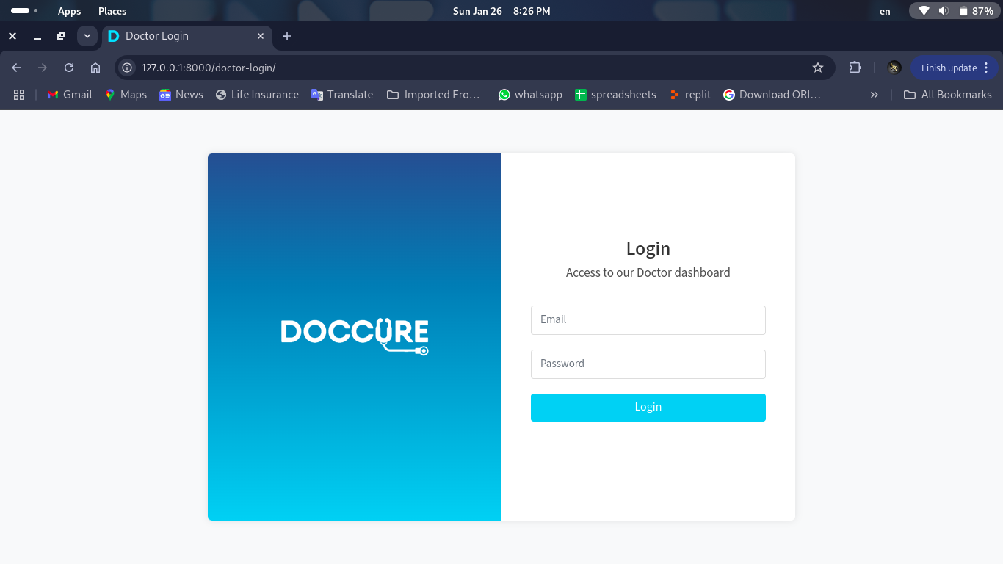
Admin:- Login Form Page

Slide 37
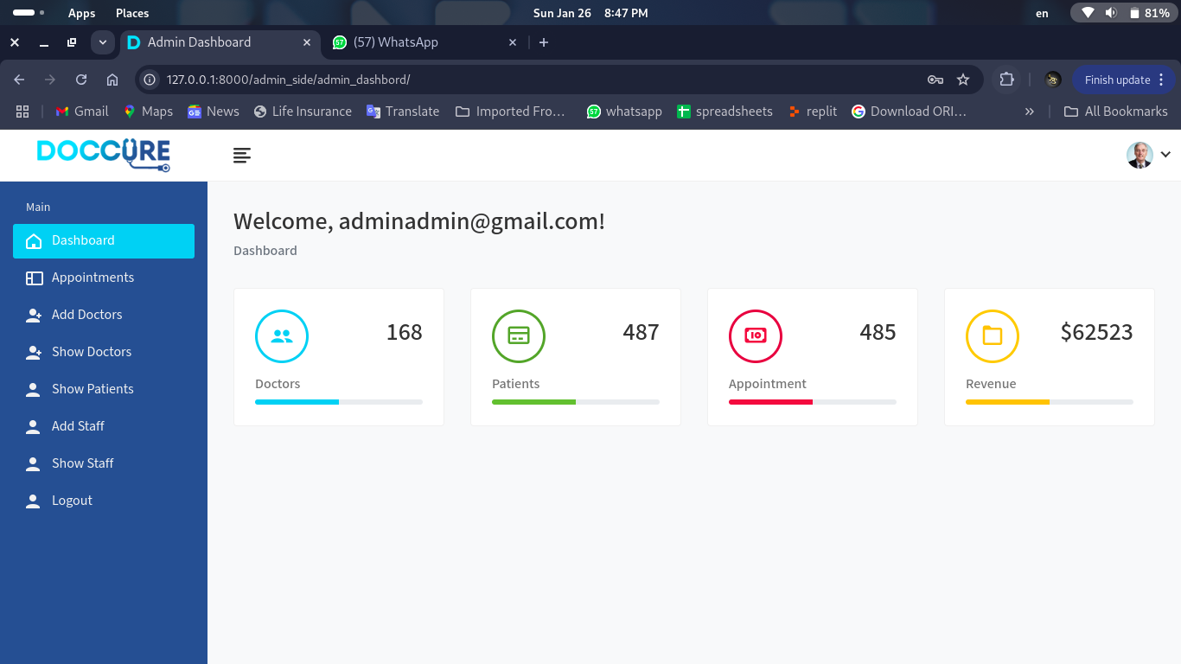
Admin:- Dashboard

Slide 38
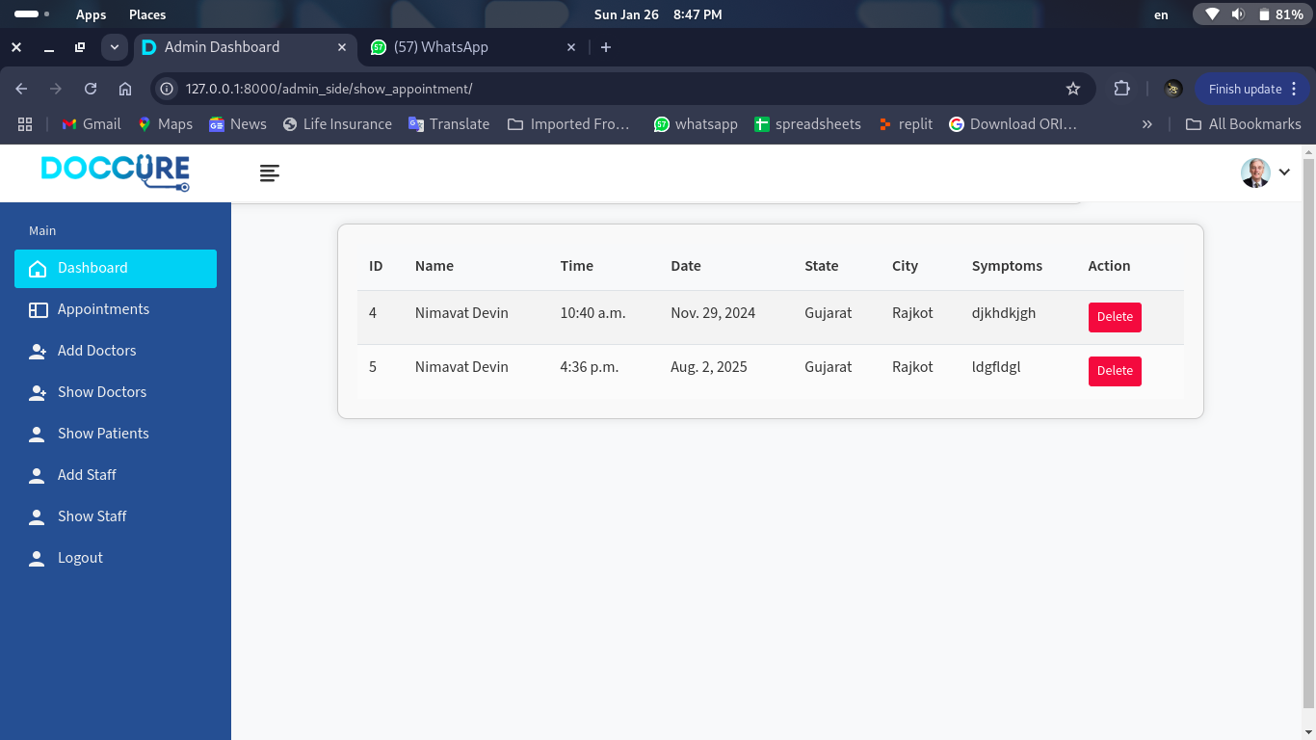
Admin:- View Appointment

Slide 39
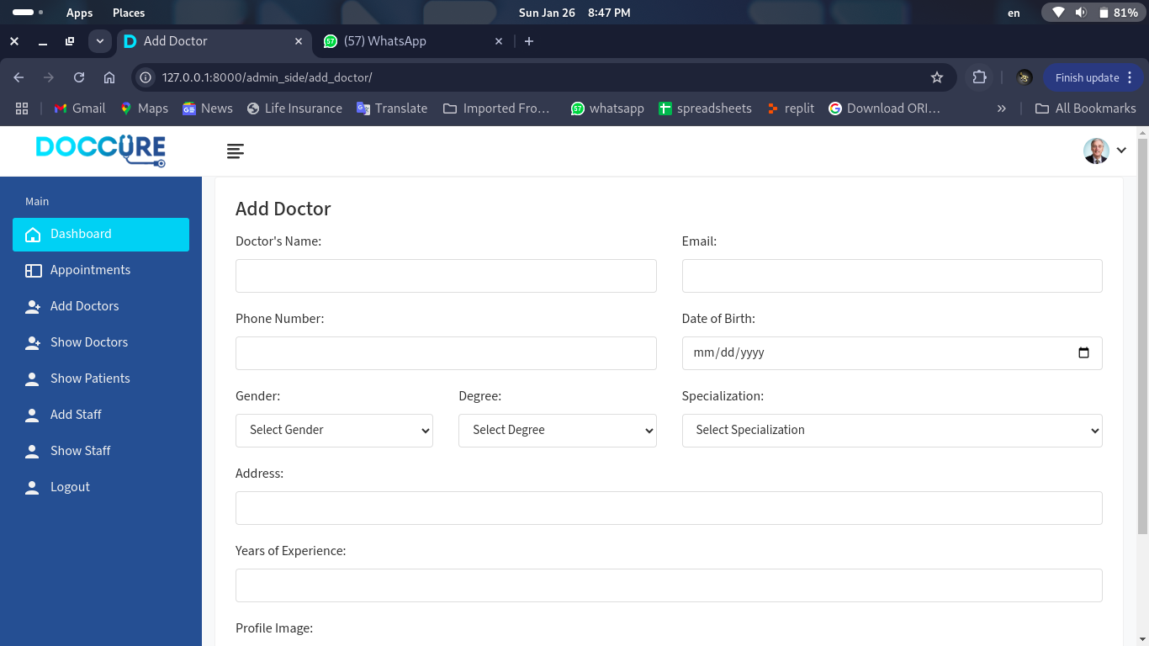
Admin :- Add Doctor

Slide 40
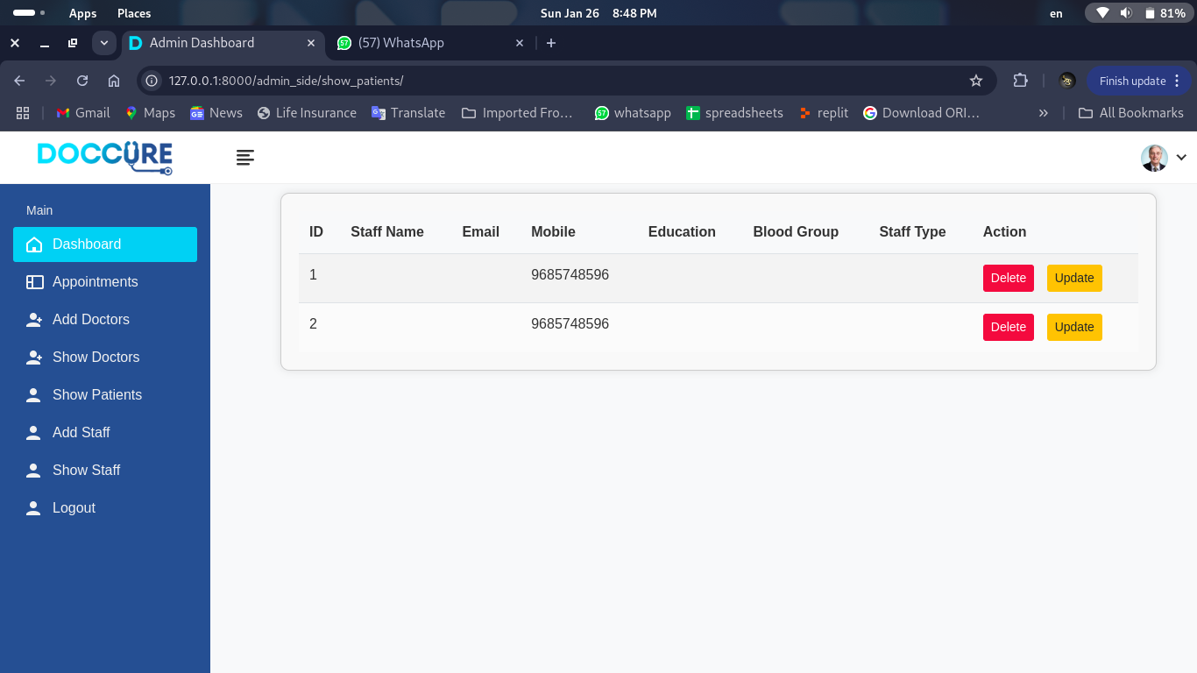
Admin :- View Staff

Slide 41
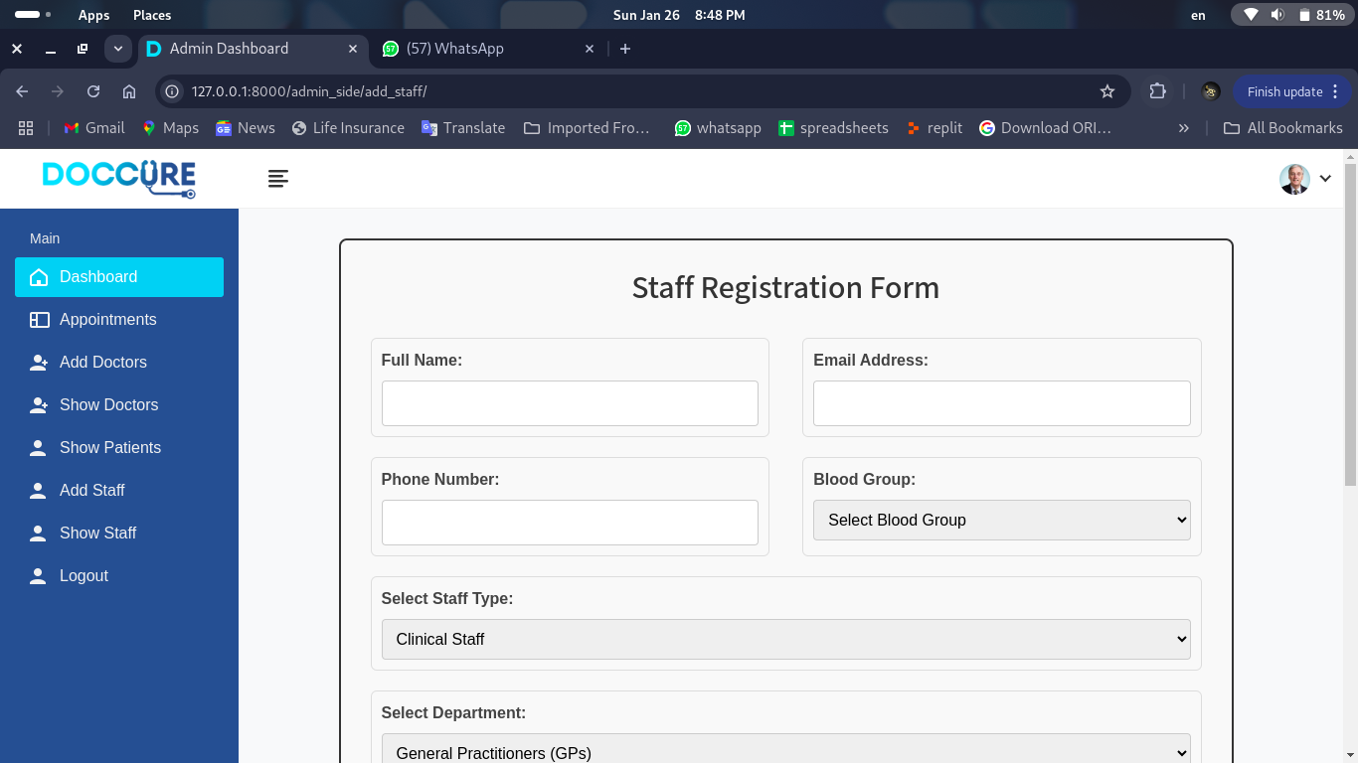
Admin :- Add Staff

Slide 42
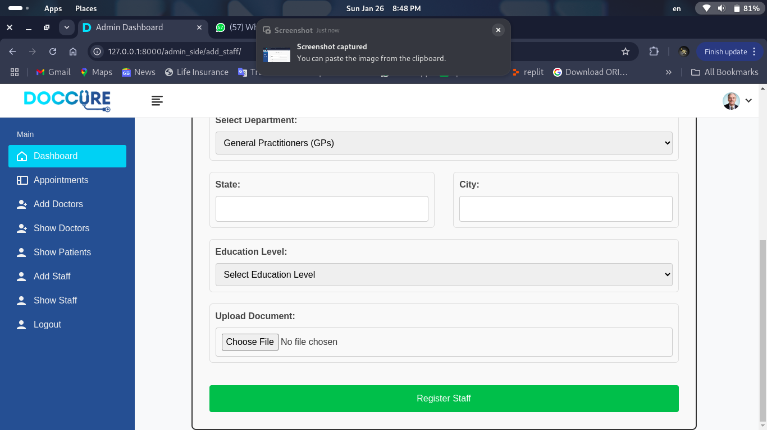

Slide 43
Input-Design For User

Slide 44
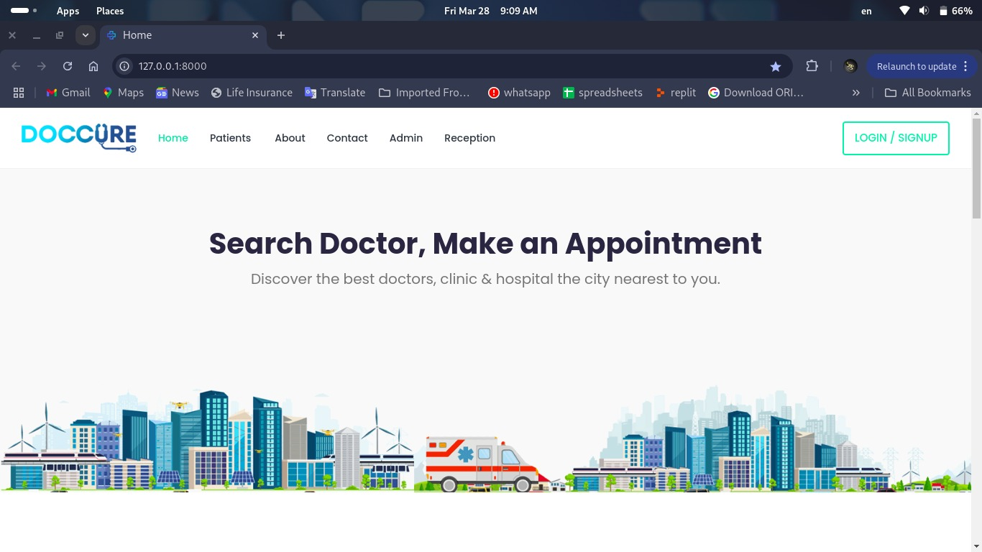
User :- Home Page

Slide 45
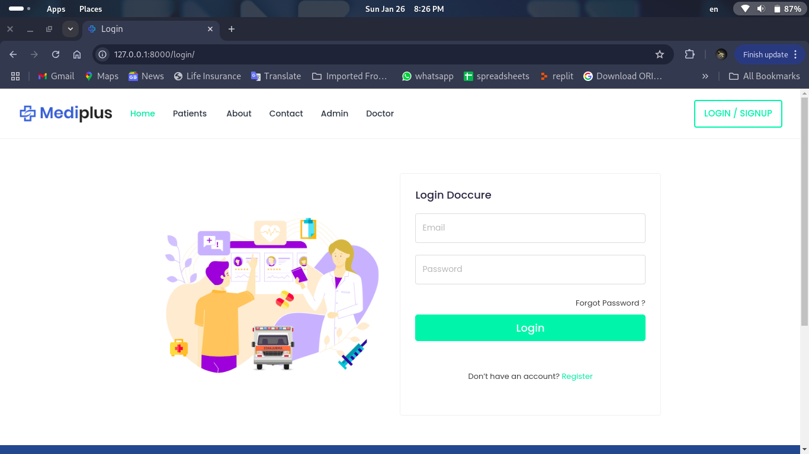
User :- Login Form Page

Slide 46
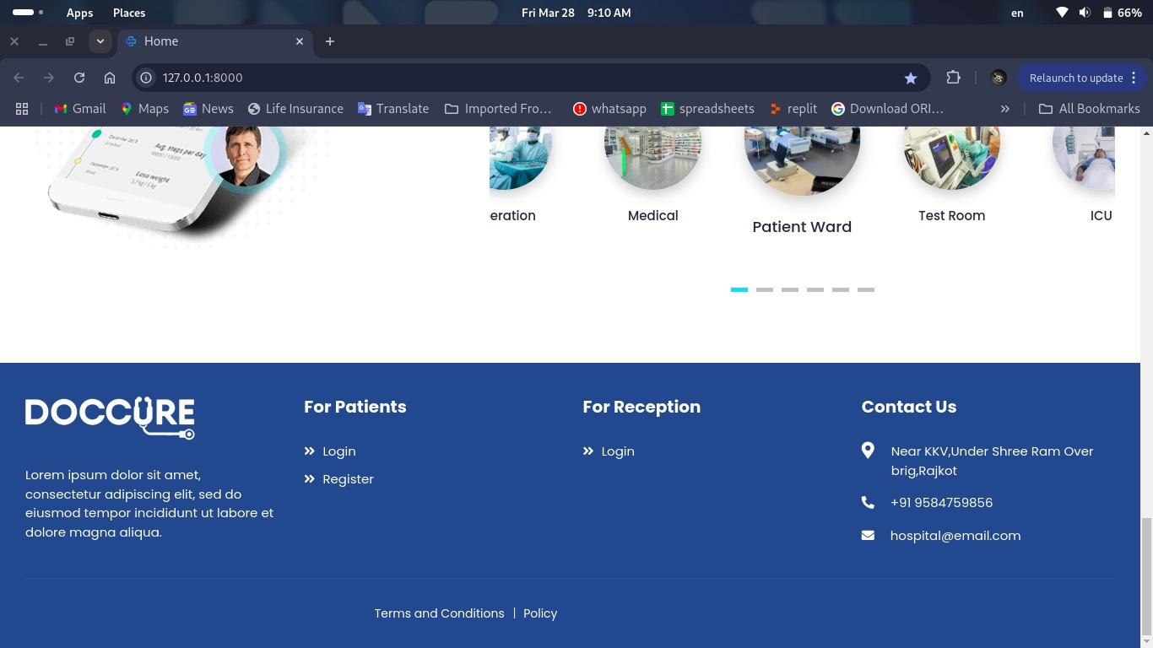

Slide 47
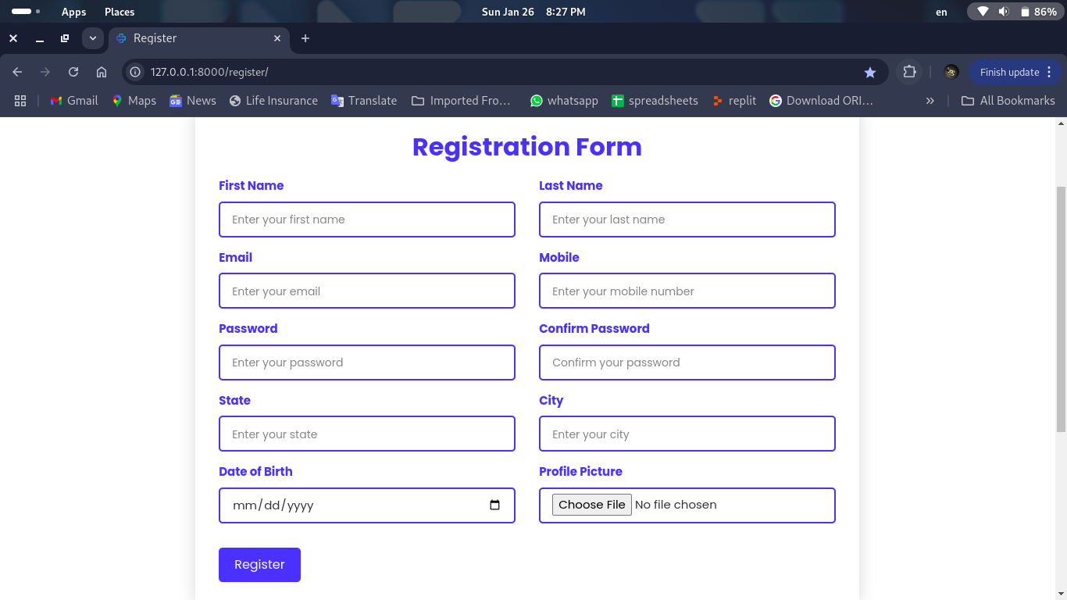
User :- Registration Page

Slide 48
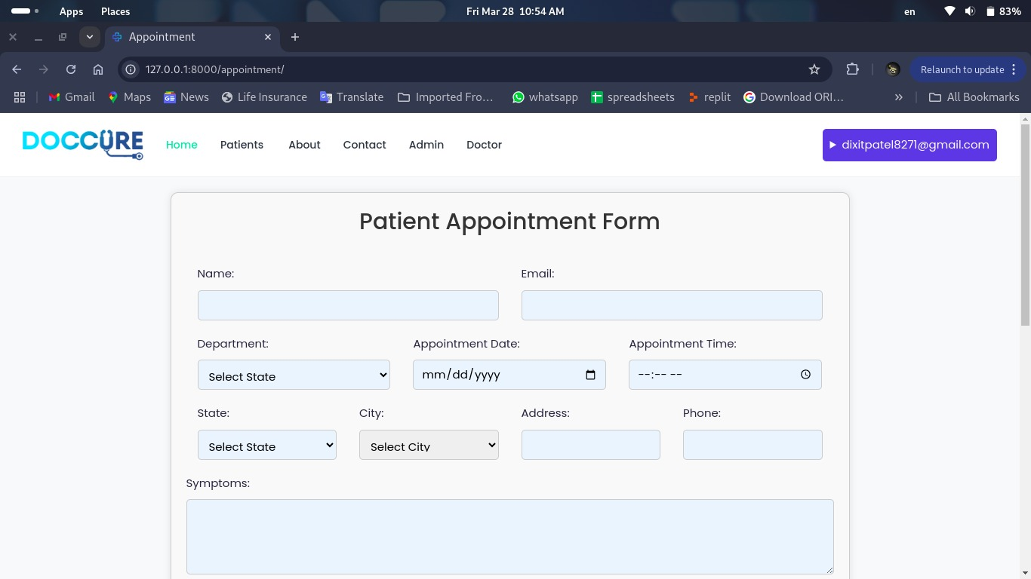
User :- Book Appointment

Slide 49
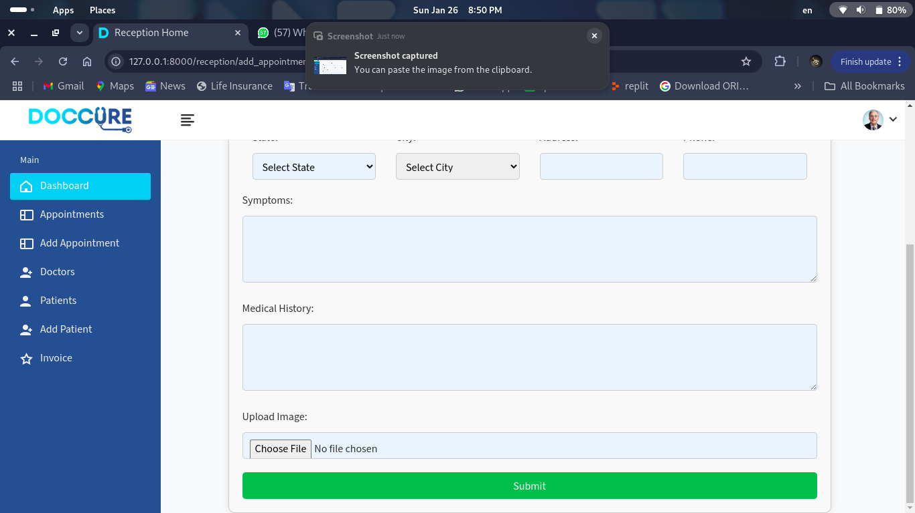

Slide 50
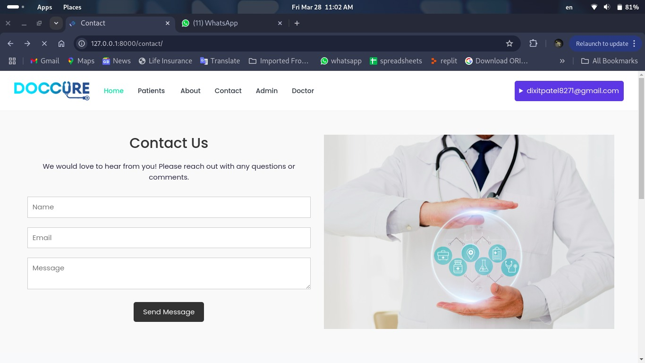
User :- Contect

Slide 51
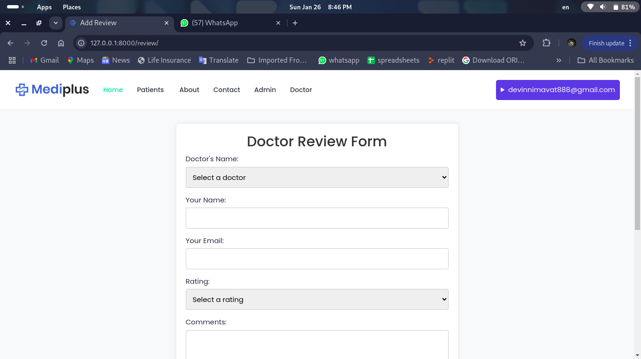
User :- Give Feeback

Slide 52
Input-Design For Reception

Slide 53


Slide 54
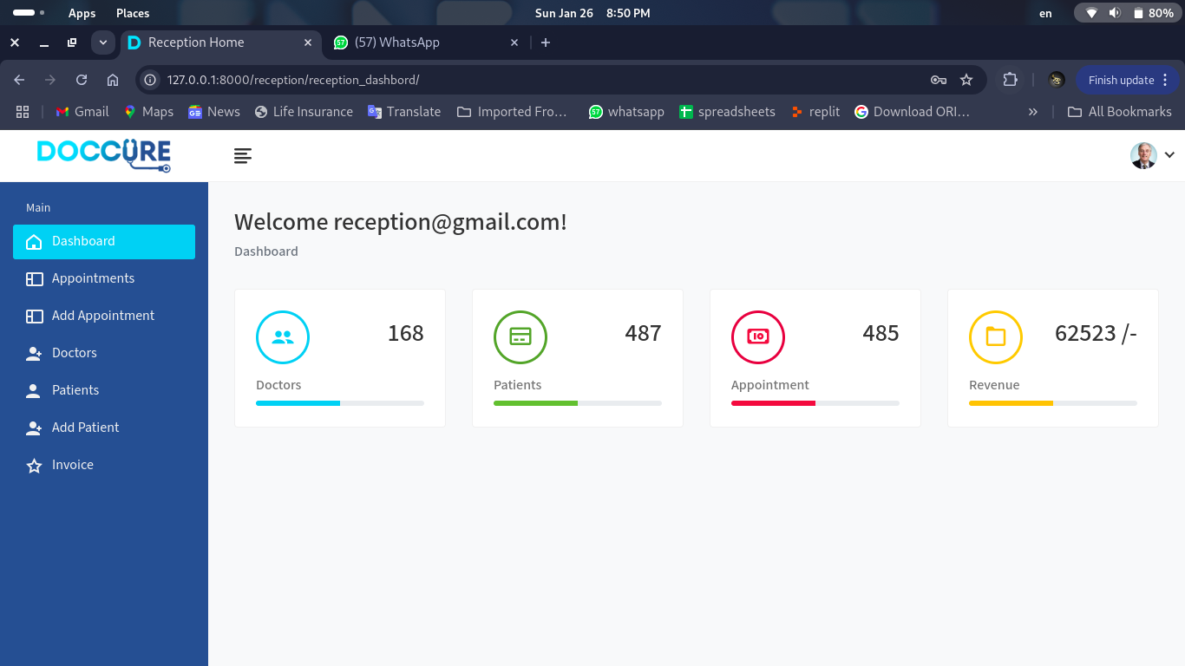
Reception :- Home Page

Slide 55
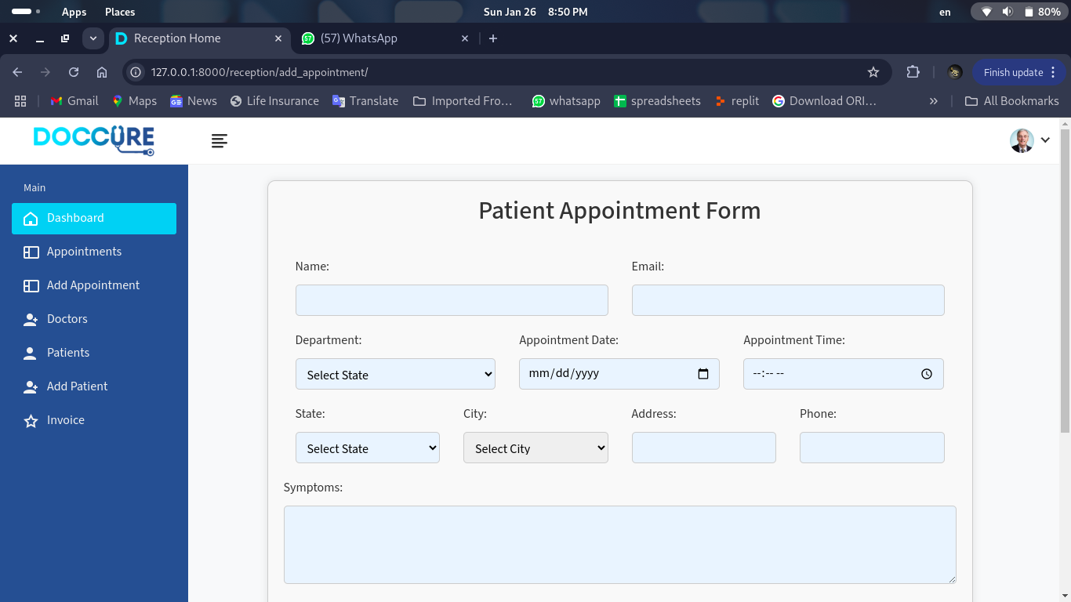
Reception :- Book Appointment

Slide 57
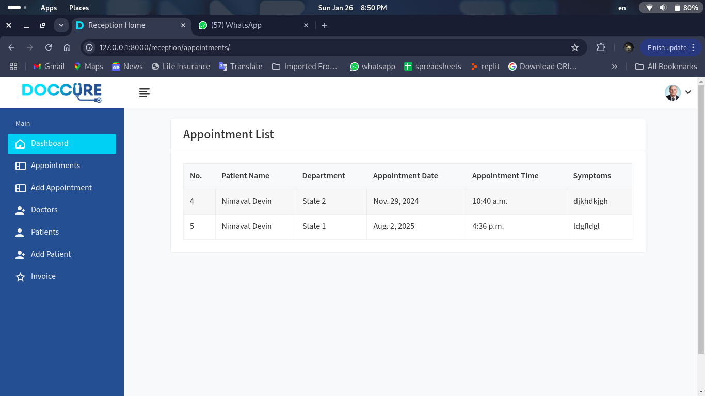
Reception :- View Appointment

Slide 58
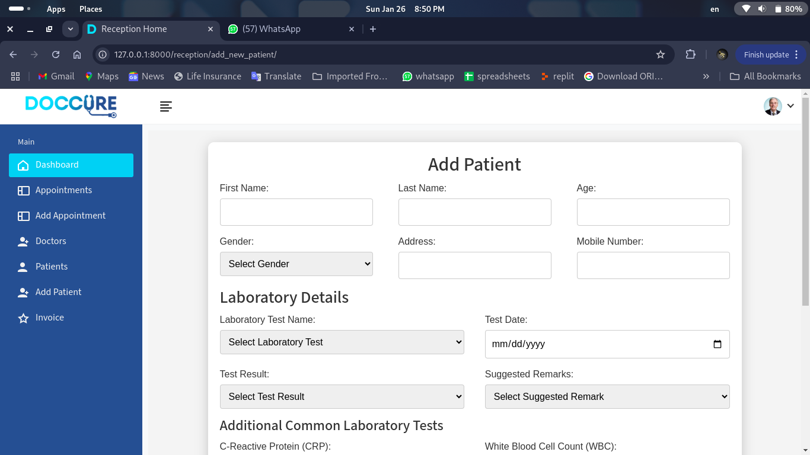
Reception :- Add Patients

Slide 59
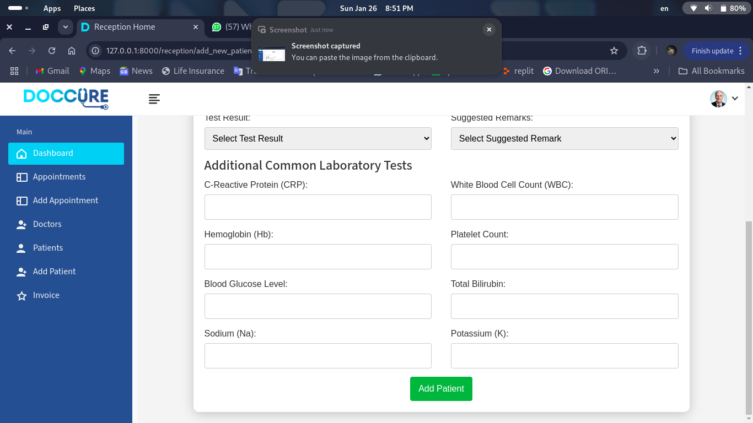

Slide 60
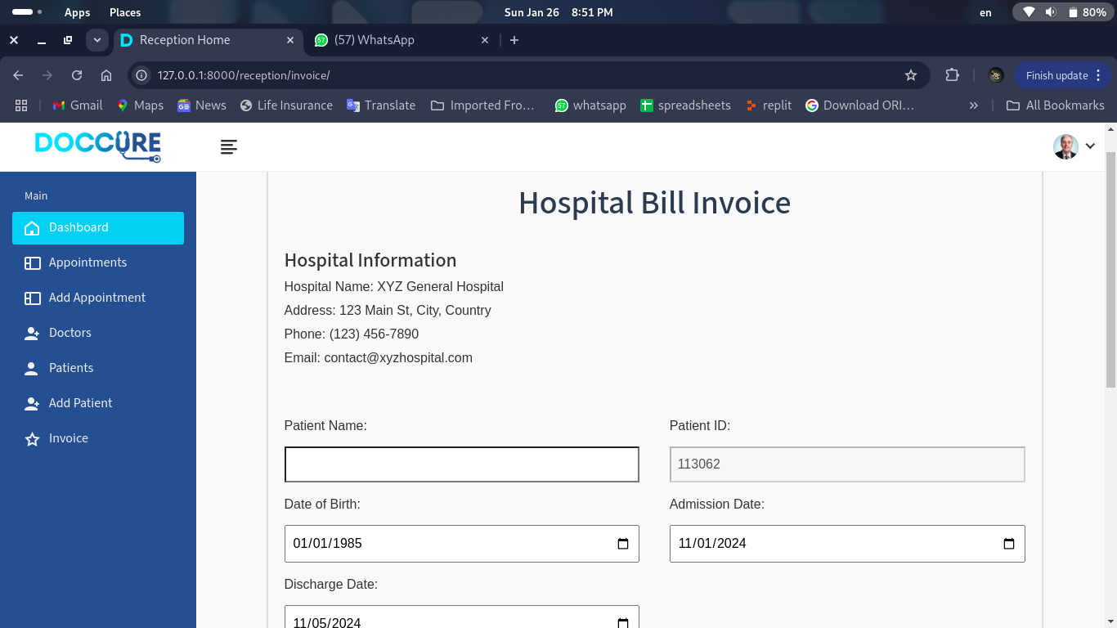
Reception :- Generate Bill

Slide 61
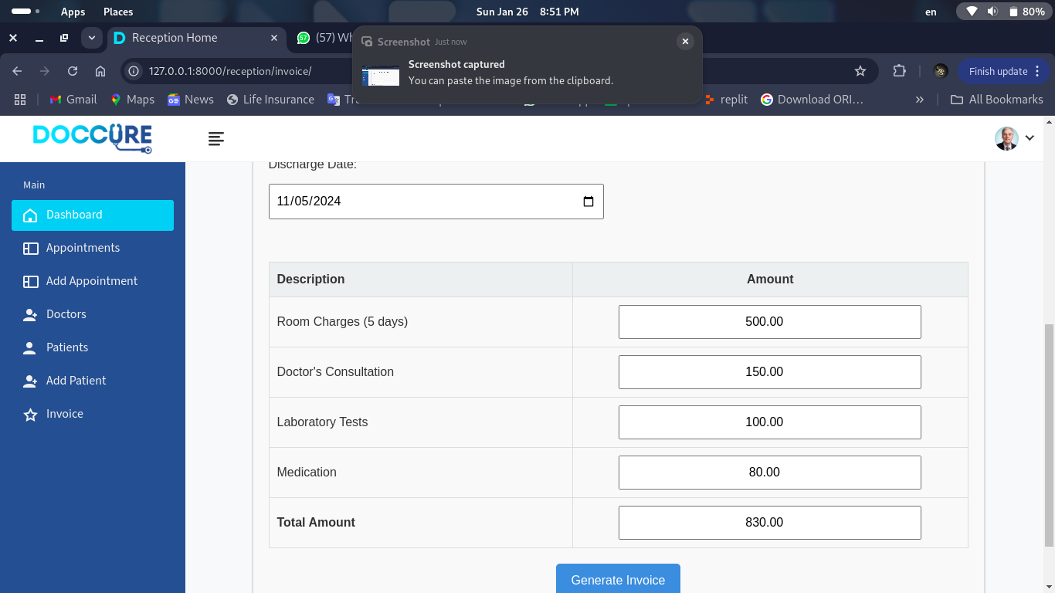

Slide 62
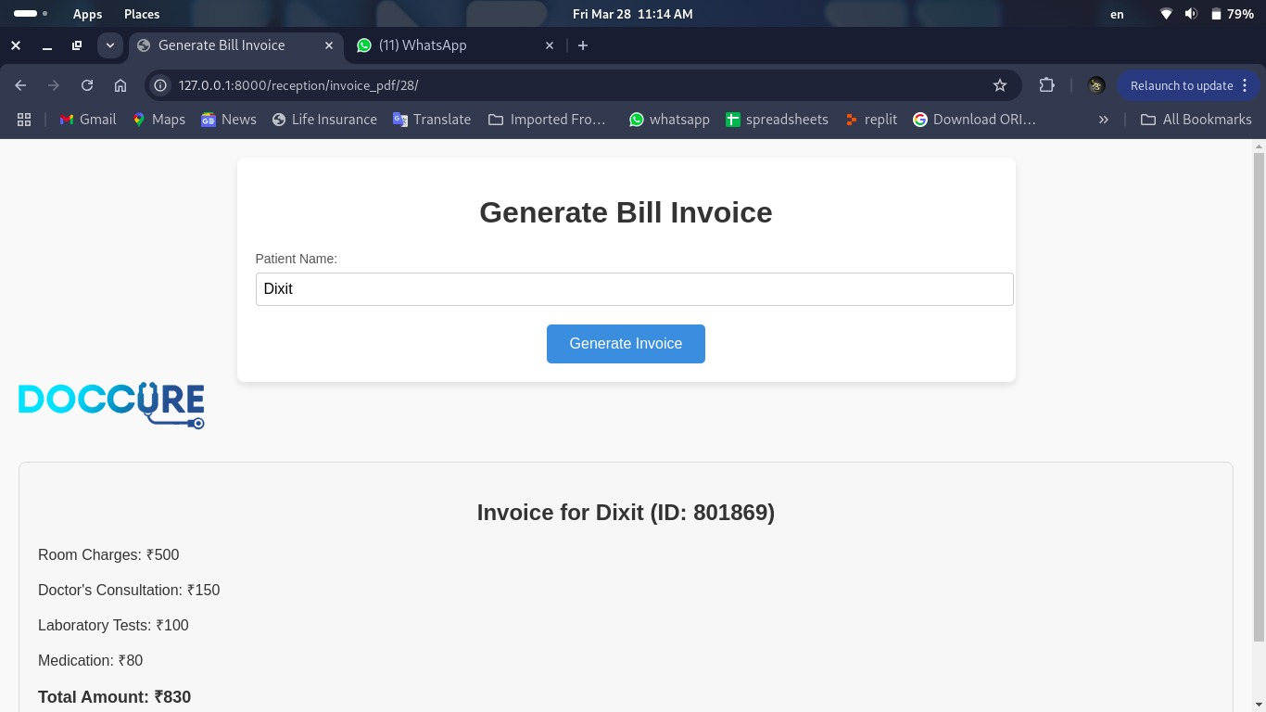

Slide 63
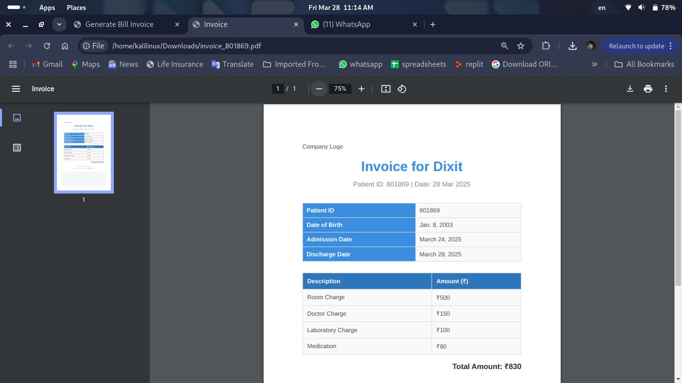
Reception :- Download Bill Receipt

Slide 64
THANK YOU

